Slide 1
Capstone Project
By Ajaya Rai (AJ)

Slide 2
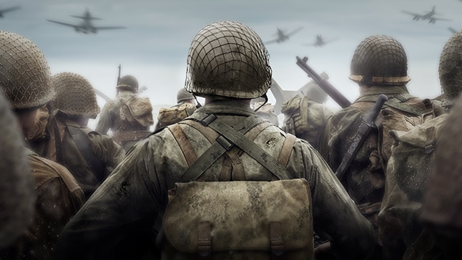
Background
What is brotherhood? -> Relationship of brothers.
Adv/Disadv of brotherhood -> It’s amoral. Positively using it; e.g. self improvement.
Why brotherhood lost in our society? -> Two evolution: Maximise individual gain + Community
How have others gone about creating the brotherhood within our society? -> Using initiative, e.g. sleeping over to neighbour house, seeing existing friends who are like minded, finding existing group else creating your own.
[999]
Notes:
Cuz I want to bring brotherhood in the modern world
What is brotherhood?
Adv/Disadv
If brohood is soo good why is it lost In our society?
How have others gone about solving this problem?
Why building an app is one of the best ways to solve this issue?
Aim is to bring the brotherhood to our modern civil life. Why?
Accelerate self-improvement via ‘proving each other that they deserve to be part of the team’ [6] (Background Research Section: Disadv of brotherhood)
For well-being as claimed by [8] (Background Research Section: Adv of brotherhood)

Slide 3
Background: part 2
Why building an app for creating/finding/maintaining the group is one of the best ways to solve this issue?
There’s always community/tribal groups, e.g. Facebook, Instagram, etc. But, never a gender specific, which focus is to build brotherhood. (Gap in the Market)
Finding the group/creating it is the hardest part
Takes long to find like-minded people
‘Conscious deliberate effort’
Acts as an advert/promotion

Slide 4
End Of The Year Product Target
Web-app -> Bro-App
Technologies use: ReactJS + Firebase
ReactJS:
Built by Facebook; and other social media app are moving towards ReactJS
ReactJS + Firebase:
A lot of tutorial/help
Notes:
Show what you are planning build for the whole year

Slide 5
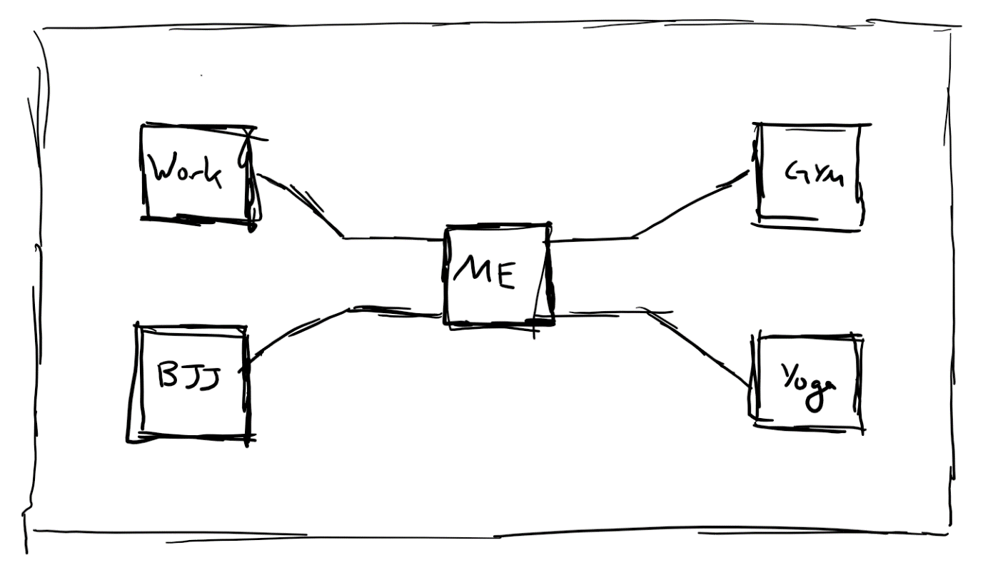
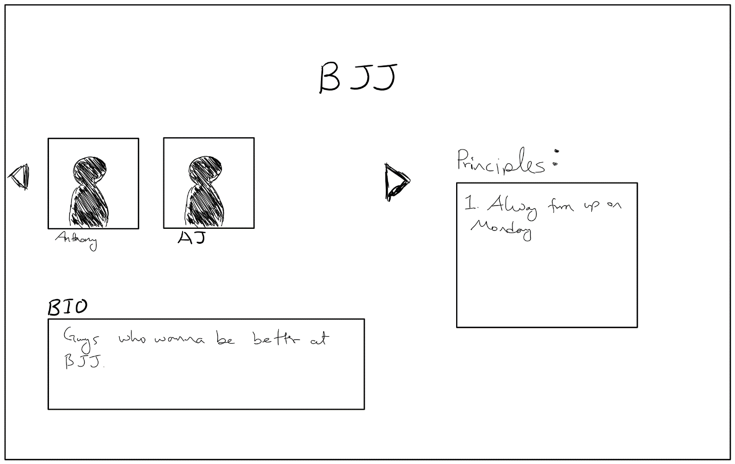
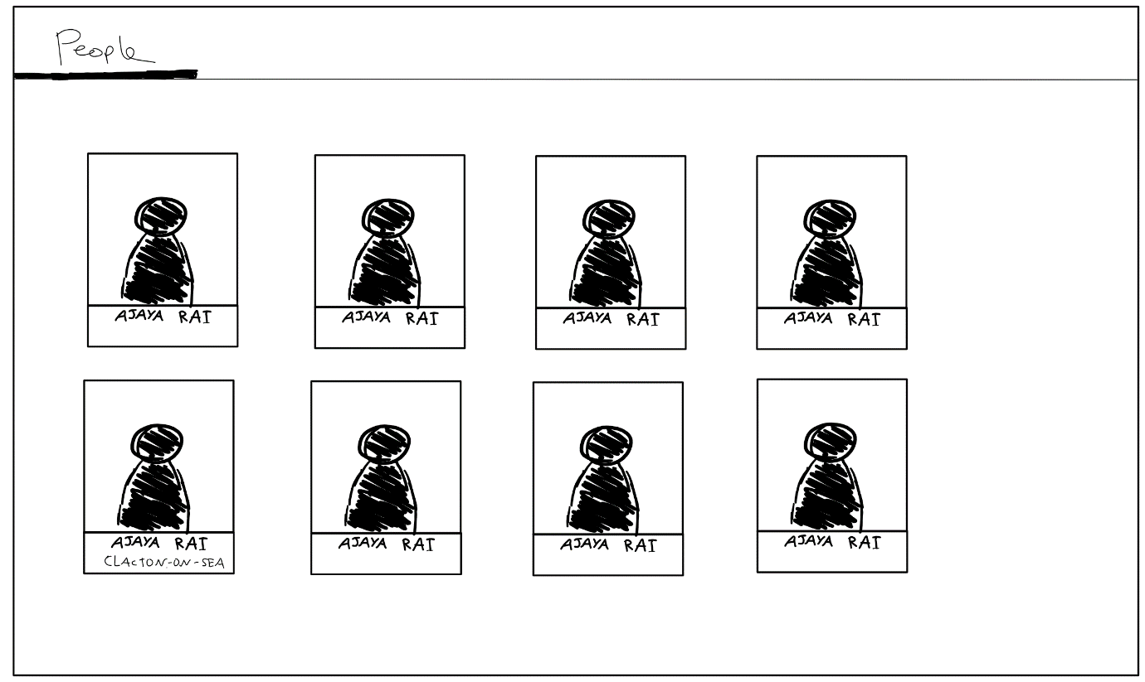
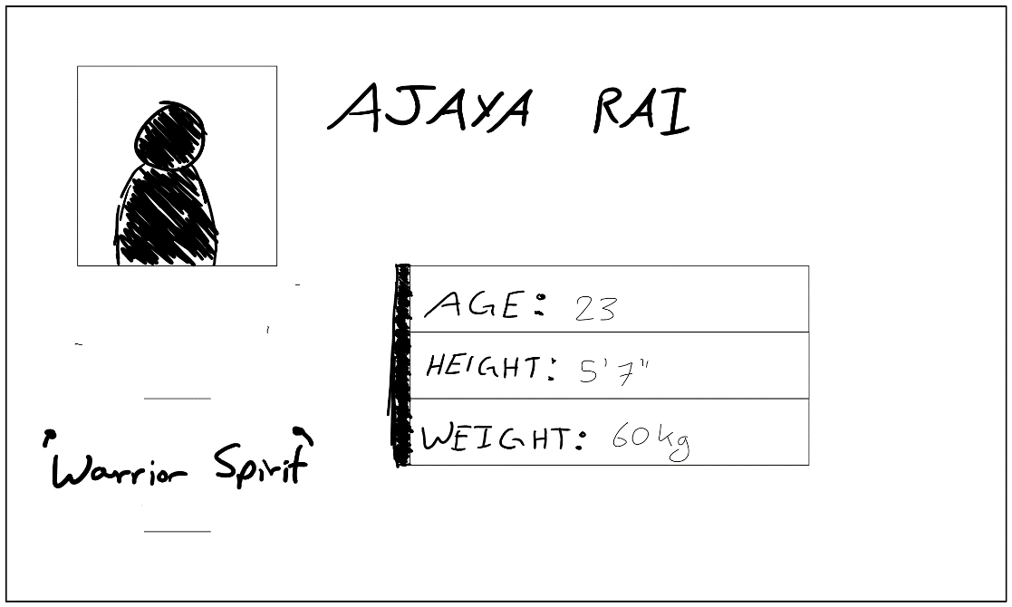

Home Page
Tribe Page
Search Page
Profile Page
Header

Slide 6
MVP target
Focus on getting the logic done

Slide 7
Technical Achievement
Demonstration

Slide 8
Questions?

Slide 9
Reference:
[999] https://www.callofduty.com/content/dam/atvi/callofduty/wwii/home/sh-overview.jpg

